Slide 1
BRAIN TUMOR DETECTION AND PATIENT SUPPORT SYSTEM
Project Guide: Mr. MARISELVAN R
TEAM MEMBERS:
B.NAVANEETHAKRISHNA(9921004501)
B.ARAVIND KUMAR(9921004037)
A.VENKATRAMAN(99210041826)
S.SANJAY(99210042079)

Slide 2
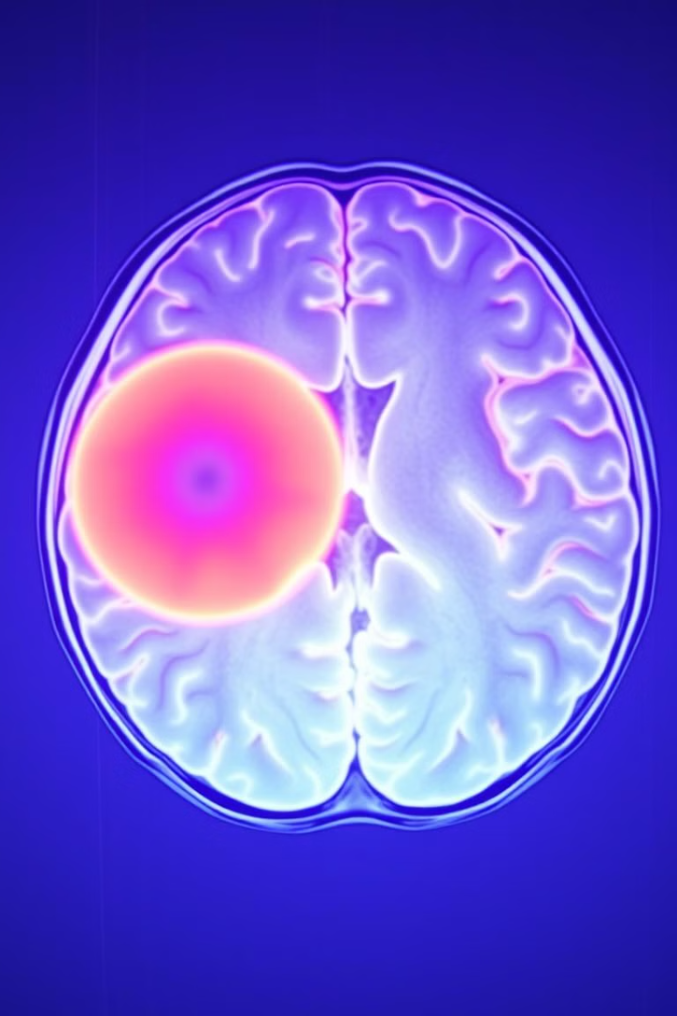
Tumor Diagnosis and Support System
Our project is dedicated to developing a web-based interface that provides patients with enhanced tumor diagnosis using a CNN-based tumor detection system. The interface identifies tumors and classifies their types, offering financial support options to ensure the overall well-being of patients. We also deploy a system for detecting brain tumors and classifying their types using MRI images uploaded by patients.

Slide 3




Problem Statement
Time-Consuming Methods
Expensive Procedures
Conventional diagnostic processes can be lengthy.
Traditional methods often involve high costs.
Prone to Human Error
Need for Early Detection
Manual diagnostic methods can be subject to mistakes.
Brain tumors require timely identification for effective treatment.
There is a pressing need for an automated system that can quickly and accurately identify brain tumors and classify their types, along with an interface that enables patients to seek donations from donors.

Slide 4
Objective
Traditional Methods
AI-Enhanced System
Conventional diagnostic approaches can be time-consuming, expensive, and prone to human error.
Our web-based interface provides enhanced tumor diagnosis using a CNN-based tumor detection system.
Lengthy diagnostic processes
Rapid tumor identification
High costs involved
Accurate tumor classification
Potential for human error
Financial support options

Slide 5




Benefits to the Community
Improved Access
Financial Support
Convenience
Our system provides convenience for patients by allowing them to easily upload MRI images and receive online analysis. It improves access to medical facilities by providing a directory of high-quality hospitals and doctors. The donation system offers secure financial support, connecting patients with donors to alleviate treatment costs.

Slide 6

Literature Review: CNN Applications
Title
Author
Overview
Brain Tumor Detection using MRI Images and Convolutional Neural Network
Driss Lamrani, Bouchaib Cherradi, Oussama El Gannour, Mohammed Amine Bouqentar
Applies CNNs to detect and classify brain tumors, demonstrating exceptional performance in identifying tumors.
Detection of tumors on brain MRI images using the hybrid convolutional neural network architecture
Ahmet Cinar, Muhammed Yildirim
Focuses on diagnosing brain tumors using MRI images and CNNs with ResNet50, enhancing specialists' efficiency and reducing errors.

Slide 7
Literature Review: Image Segmentation
Title
Author
Overview
BRAIN TUMOR MRI IMAGE SEGMENTATION AND DETECTION
Rohini Paul Joseph, C. Senthil Singh, M.Manikandan.
Uses K-means clustering for MRI image segmentation and morphological filtering to enhance images.
Detection of Brain Tumor from MRI images by using Segmentation
Swapnil R. Telrandhe, Amit Pimpalkar, Ankita Kendhe.
Proposes a tumor detection method using K-Means clustering, Object Labeling, and preprocessing techniques.

Slide 8
Literature Review: AI-Based Systems
Title
Author
Overview
An Automated Detection and Segmentation of Tumor in Brain MRI using Artificial Intelligence
M. Y.Bhanumurthy, Koteswararao Anne
Presents an AI-based system using a Neuro-fuzzy classifier for detecting and segmenting brain tumors.
Brain Tumor Detection Using Convolutional Neural Network
Tonmoy Hossain, Fairuz Shadmani Shishir
Combines Fuzzy C-Means for segmentation with CNNs for detection, ensuring high accuracy and information retention.

Slide 9
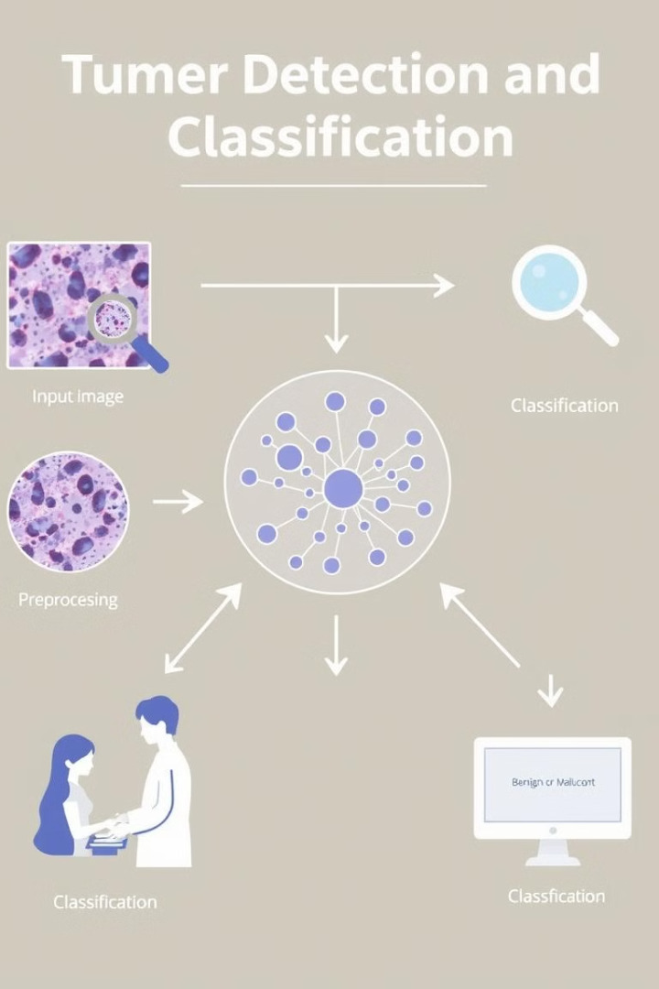



Proposed Methodology
Dataset Preparation
Source images from public datasets and preprocess and label according to tumor type.
Model Development
Develop a CNN model and train on pre-processed MRI images to detect tumors effectively.
User Interface
Design a simple and user-friendly interface for patients to upload MRI images and ask for donations.

Slide 10

Software Requirements
Frontend: React.js
User interface development.
Backend: Node.js, Express.js
API integration.
Database: MongoDB
Storing patient and donation data.
AI/ML: CNN model
MRI image processing.

Slide 11

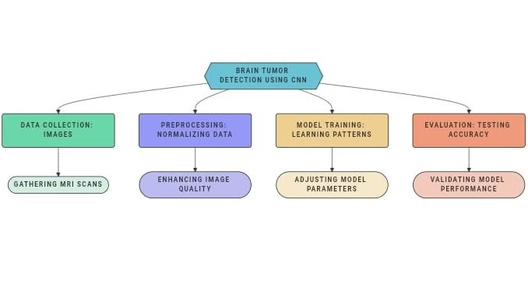
Work Flow
The workflow begins with collecting MRI images, which are preprocessed to enhance quality. These are then passed through a CNN model that learns patterns for tumor detection, followed by evaluation to validate accuracy. This ensures efficient and accurate tumor identification, forming the backbone of our patient support system.

Slide 12
Conclusion
Our project combines deep learning and React technology to offer a comprehensive solution for brain tumor detection, doctor interaction, and financial support. By providing accurate diagnosis and seamless communication, it empowers patients throughout their treatment journey. The system also enables users to contribute to medical expenses directly or through crowdfunding campaigns, easing the financial burden for patients in need of treatment.
References
Driss Lamrani, Bouchaib Cherradi, Oussama El Gannour, Mohammed Amine Bouqentar, Lhoussain Bahatti,2022. [Brain Tumor MRI Image Segmentation and Detection in Image Processing]. [International Journal of Advanced Computer Science and Applications].

Slide 13
M.Y.Bhanumurthy, Koteswararao Anne,2014, [An Automated Detection and Segmentation of Tumor in Brain MRI using Artificial Intelligence], [IEEE International Conference on Computational Intelligence].
Tonmoy Hossain, Fairuz Shadmani Shishir, Mohsena Ashraf MD Abdullah Al Nasim, Faisal Muhammad Shah,2019.[Brain Tumor Detection Using Convolutional Neural Network],[2019 1st International Conference on Advances in Science, Engineering and Robotics Technology (ICASERT)].
Rohini Paul Joseph, C. Senthil Singh, M.Manikandan.2014. [BRAIN TUMOR MRI IMAGE SEGMENTATION AND DETECTION IN IMAGE PROCESSING], [International Journal of Research in Engineering and Technology].
Swapnil R. Telrandhe, Amit Pimpalkar, Ankita Kendhe, 2016. [Detection of Brain Tumor from MRI images by using Segmentation &SVM], [2016 World Conference on Futuristic Trends in Research and Innovation for Social Welfare].
A Çinar, M Yildirim, 2020. [Detection of tumors on brain MRI images using the hybrid convolutional neural network architecture] [Medical hypotheses].

Slide 14

Thank You

